Slide 1
WorkitSA
Everyday work, found nearby — verified, trusted, low-data.
Challenge: Youth employment & work readiness
#FNBHackathon
Team Workitsa · solo entry · live at workitsa.co.za
Tshepo Joshia Moyo · Futhersky Solutions (Pty) Ltd · FNB App of the Year Hackathon 2026
Notes:
Open in 10 seconds: 'I'm Tshepo, solo team Workitsa. WorkitSA is a live, verified gig-work marketplace that connects young South Africans to everyday work nearby. For this hackathon I built a WhatsApp job channel so even a worker with no data can find and accept work.' Say the challenge out loud: youth employment & work readiness.

Slide 2
THE PROBLEM
The willingness is there. The bridge to income isn't.
▸ Youth unemployment ~45%. Nearly half of young South Africans (15–34) can't find work. [StatsSA QLFS]
▸ Skills don't translate to income. Millions have real, practical skills but no credible way to prove them to a stranger.
▸ Looking for work costs money. Job seekers burn scarce airtime, data and taxi fare chasing work that may not even exist.
▸ Trust is the blocker. Employers can't tell who's reliable or nearby, so informal work stays stuck in word-of-mouth.
“
The gap isn't effort.
It's a trusted, low-data bridge between a worker and the next job.
Notes:
This slide scores IMPACT. Land the human cost: a worker spends R30 of airtime and a R40 taxi to chase a job that was already taken. Keep it to ~20 seconds, then pivot to the solution.

Slide 3
THE SOLUTION — LIVE TODAY
A verified, two-sided marketplace for everyday work.
▸ Post a job. Employers post everyday work — cleaning, gardening, trades, deliveries, errands.
▸ Get matched. Nearby verified workers are alerted; they accept or counter-offer.
▸ Get it done, get paid. Work happens, paid in cash/EFT, both sides rate each other.
▸ Build a record. Every completed job becomes a portable, verifiable work history.
▸ Trust-first. Real-person ID checks, ratings, and time-stamped proof-of-work photos.
[ SCREENSHOT ]
find-work job feed on a phone (workitsa.co.za/find-work)
Live PWA · Gauteng · low-end Android · en / af / zu
Notes:
This scores PRODUCT. Stress it is LIVE, not a concept. Mention it's a PWA built for low-end Android and works in English, Afrikaans and Zulu. Screenshot: the find-work feed.

Slide 4
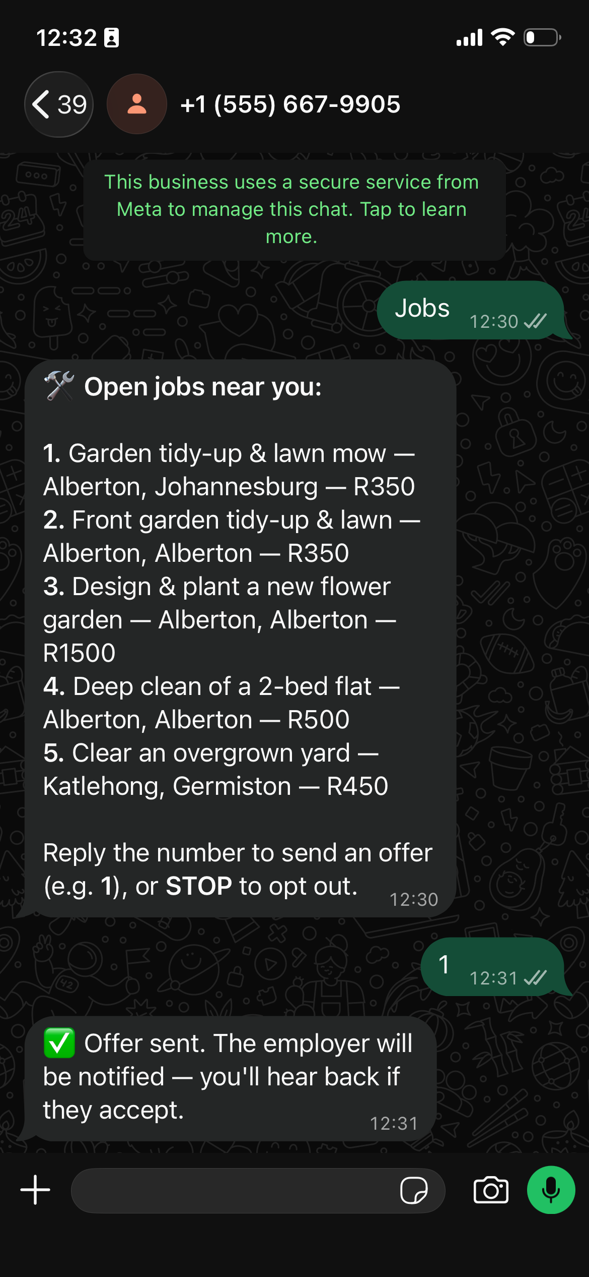
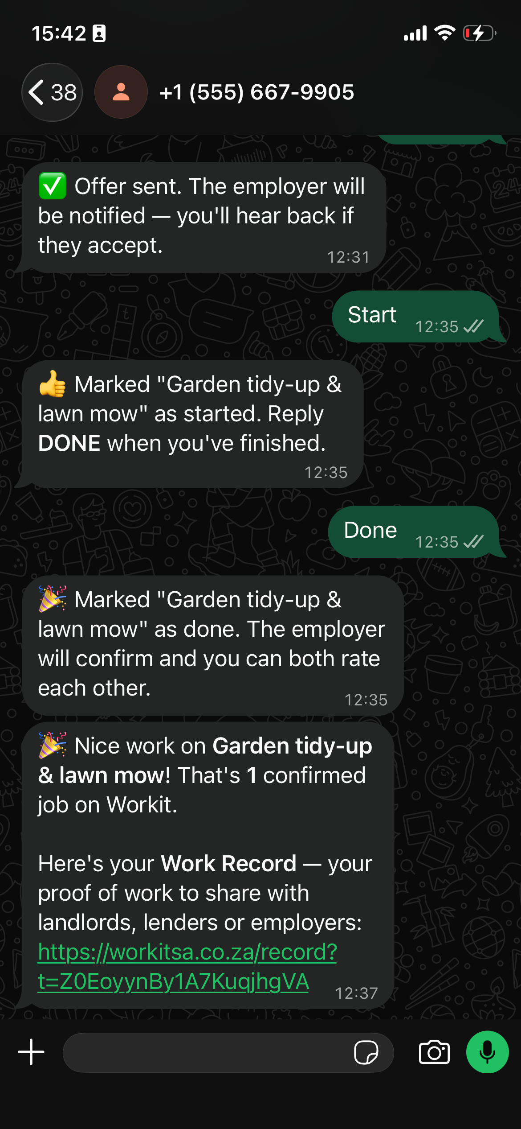
BUILT AT THE HACKATHON
The WhatsApp Job Channel — no app, no data needed.
▸ Meet workers where they are. Many can't keep a data-hungry app open. WhatsApp, they already have.
▸ JOBS → get the nearby jobs that match you.
▸ ACCEPT 3 → makes an offer to the employer instantly.
▸ ON MY WAY / DONE → update the job status by text.
▸ Push alerts when a matching job appears within 10 km of you.
▸ POPIA-safe. Opt-in, free STOP anytime, and no ID or personal data is ever sent over WhatsApp.
Find & offer
Do it & get paid
Notes:
This scores CREATIVITY and ties straight back to the challenge's 'transport and data barriers'. This is the NEW feature built during the weekend (hackathon rule for an existing app). Demo it live if you can; otherwise the WhatsApp screenshot carries it.

Slide 5
USER JOURNEY
Thabo's first R450.
1
2
3
Sign up free
on his phone — or straight from WhatsApp.
Verify once
ID checked by a real person.
Get alerted
“Fix a leaking tap · R450 · Alberton.”
4
5
6
Accept
replies ACCEPT — offer reaches the employer.
Do the work
marks DONE, uploads a time-stamped photo.
Get paid & rated
and keeps a verifiable record for next time.
Notes:
This is the required USER-JOURNEY STORY. Tell it as one continuous sentence about a real person — judges remember a story, not a feature list. ~25 seconds.

Slide 6
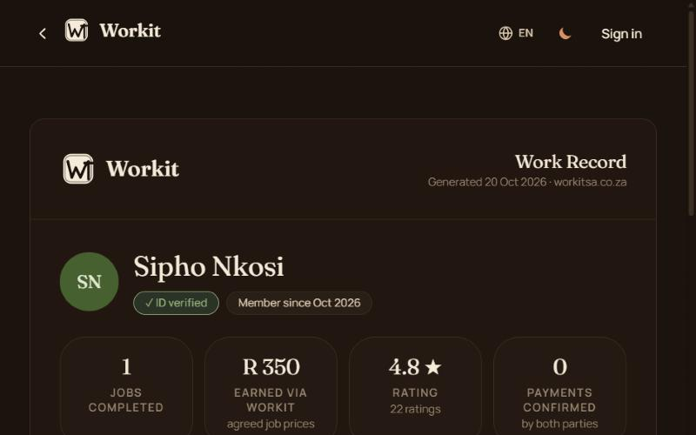
TRY IT YOURSELF
Demo details for the judges.
Live app
https://workitsa.co.za
Judge login
[DEMO EMAIL] / [DEMO PASSWORD] (pre-verified account)
WhatsApp demo
Save +27 67 748 2643 and send JOBS
Shareable Work Record — proof of work
Demo video (<=90s)
[ PASTE VIDEO LINK HERE ]
Seeded with real Alberton activity so the marketplace is never empty when judges open it.
Notes:
REQUIRED: demo account + demo video link live on a slide. Create the judge account BEFORE submitting (Part 4). Paste the final video link here and on slide 10. WhatsApp demo line is +27 67 748 2643 — the founder's personal number is never shown.

Slide 7
INTELLIGENCE
An app that thinks.
▸ Jarvis. A Gemini-powered co-pilot: morning digest, dispute/anomaly alerts, ask-anything over live data — even over WhatsApp.
▸ Smart matching. Jobs routed to the right workers by category, geo-radius (haversine) and availability — nearest first.
▸ Live Pulse cockpit. Real-time demand/supply heatmap that auto-zooms to the busiest suburb and surfaces offers & available-now.
▸ Fraud signals. Duplicate-document and ban-registry checks flag risky sign-ups automatically.
[ SCREENSHOT ]
Live Pulse heatmap + Jarvis chat (/admin)
Notes:
This scores INTELLIGENCE (a full 10 points most entries will miss). Emphasise the app learns from data patterns — matching, the live demand heatmap, and automatic fraud detection.

Slide 8
ARCHITECTURE & SECURITY
Built secure, built for South Africa.
Technical architecture
Security & compliance
Next.js PWA (static export)
▸ TOTP MFA enforced for all admins
▸ Real-person ID verification before you can trade
▸ Firestore security rules + automated rules tests
▸ Sensitive ID docs isolated in a private subcollection
▸ HMAC-signed WhatsApp webhook (rejects forged calls)
▸ POPIA: consent, opt-in, and a documented erasure runbook
Firebase Auth — phone OTP / email / Google
Firestore + Cloud Storage
Cloud Functions (africa-south1)
FCM push · WhatsApp Cloud API · Gemini
All data resident in africa-south1
Notes:
Required: architecture + security. Judges from a bank care a lot about this. Hit MFA, ID verification, data residency in africa-south1, and POPIA.

Slide 9
SUSTAINABILITY — PATH TO REVENUE
Free to grow, then a clear path to revenue.
8%
service fee
paid by the job poster
R49
Gold badge
premium verification
R20
boosted post
more visibility
R199
/ month
business plan
▸ Launch is free — the priority is marketplace liquidity (workers + jobs) first.
▸ Running cost ≈ R14,100 / month · break-even ≈ 500 completed jobs / month.
▸ The moat is data. We own POPIA-compliant verified-worker and work-record data no feed can replicate.
Notes:
This scores SUSTAINABILITY + the required commercialisation strategy (needed because a WhatsApp bot is part of the entry). Know these four numbers cold. Break-even at ~500 jobs/month is very reachable in one metro.

Slide 10
IMPACT & VISION
From Gauteng to the whole country.
140+
users
110+
workers
25+
ID-verified
Real accounts in Gauteng (demo/seed data excluded) — and growing weekly.
▸ 12-month target. 3,000 verified workers · 1,500 job posters · 1,500 completed jobs.
▸ Roadmap. Province-by-province rollout · BluLever artisan pipeline · employer/SME accounts.
▸ Every verified job is a young person one step closer to stable income.
Demo video
[ PASTE LINK ]
workitsa.co.za · Team Workitsa
Notes:
Close on IMPACT and land the mission in one line: 'Every verified job is a young person one step closer to income.' Make sure the demo-video link is pasted here and on slide 6 before you submit.

